Slide 1
41183 PRIVACY PRESERVING
Lecture 5. Differential Privacy II

Slide 2
About Assignment 1
Due on September 11, 2026, Friday.
Group work (learning – attitude of learning or training).
One submission per group at Canvas
- include clearly the student ID, name of group members at the first page
- include the percentage of contribution at the end of the report.

Slide 3
Outline
Sensitive data collecting
Local differential privacy
Applications of differential privacy
Differential privacy for deep learning

Slide 4
Sensitive information collection
We do survey on sensitive data online or offline
Political opinions
Religious beliefs
Trade Union membership
Health data
Data about sexual orientation
Have you cheated last semester
In order to make sure the data accuracy, we have to make it concern free

Slide 5
Sensitive information collection
In general, we have to guarantee privacy concern free
Hide the content
e.g., encrypt the content, however, you have to trust the server
Hide the identification of the users (a better solution for privacy)

Slide 6
Sensitive information collection
A surveying technique – randomized response
to answer the questions, the respondent
Toss a coin in secret, if it is head, answer truthfully
In case of tails, toss the coin in secret again
if it is tail again, answer “Yes”
if it is head, answer “No”
Following the protocol, we can collect sensitive information while keep the privacy of the respondents.

Slide 7
Hide ID for Privacy Protection
Anonymous communication
e.g., use TOR
Refer to Chapter 8 of the reference book (Security and Privacy in Federated Learning)

Slide 8
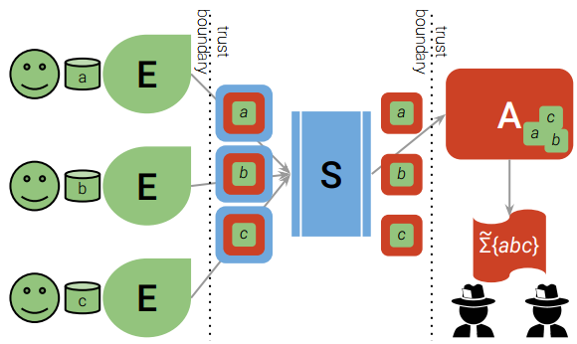
Hide ID for Privacy Protection
Shuffle model
Refer to Chapter 8 of the reference book (Security and Privacy in Federated Learning)

Slide 9



Local Differential Privacy (LDP)
Using differential privacy to work on the content part for privacy preserving
Alice
LDP
Public Users or Entities
Original Dataset D
Bob
Curator
Cathy
Data Collecting
Data Release/Sharing

Slide 10
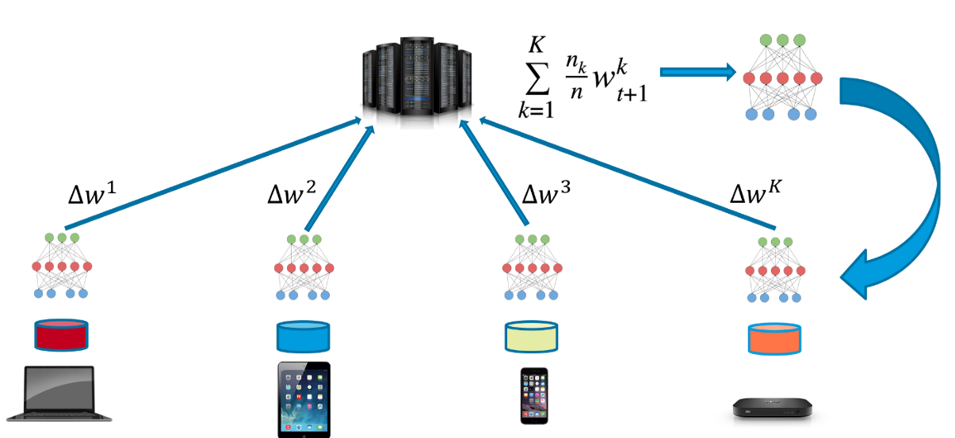
Local Differential Privacy (LDP)
Application Examples: federated learning

Slide 11
Key difference between DP and LDP
DP is used to protect the privacy of a statistical information retrieval services, in other words, the attackers are the users.
LDP is used to protect the privacy of users against malicious servers, e.g. in sensitive information collection (did you cheat in the exam?)

Slide 12
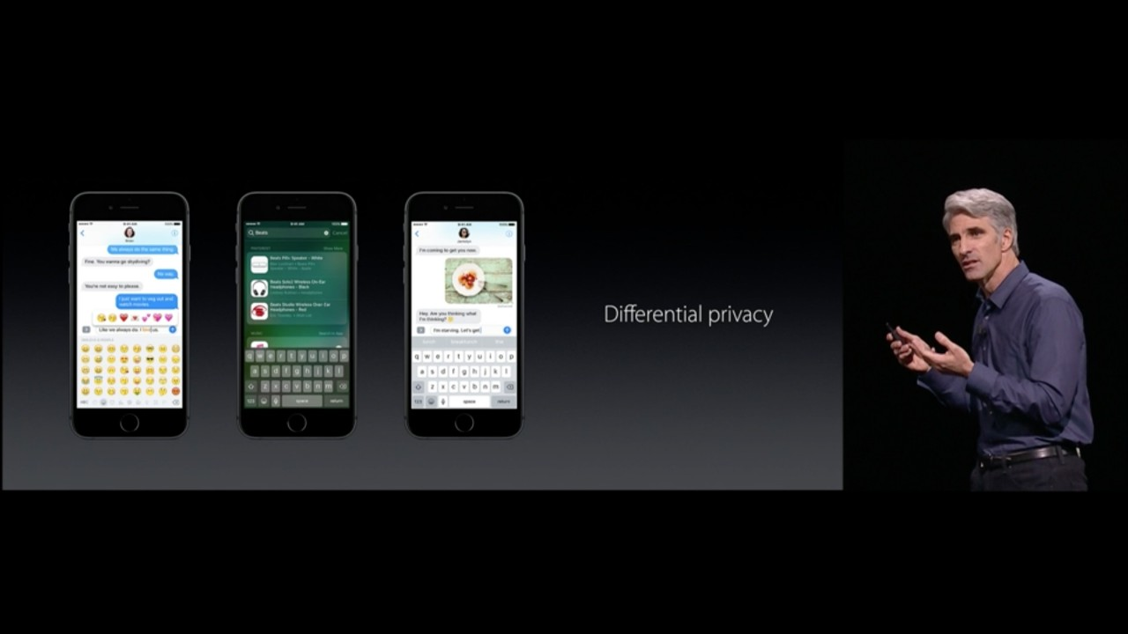
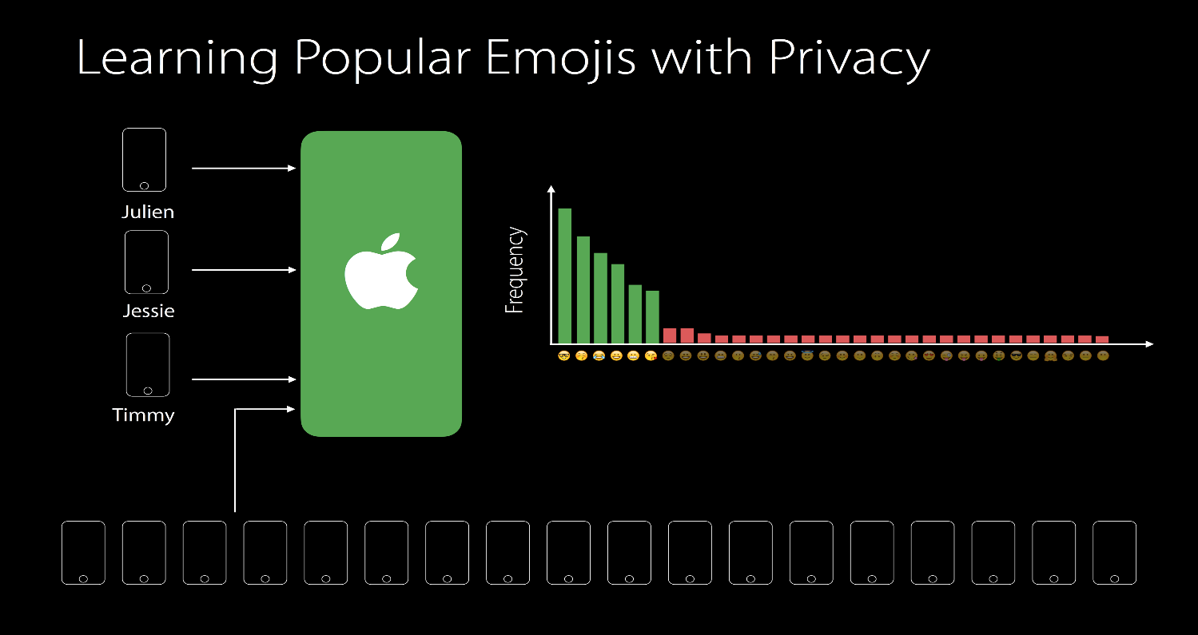
Apple Differential Privacy
Notes:
Release IOS 10, http://www.theverge.com/2016/6/17/11957782/apple-differential-privacy-ios-10-wwdc-2016

Slide 13
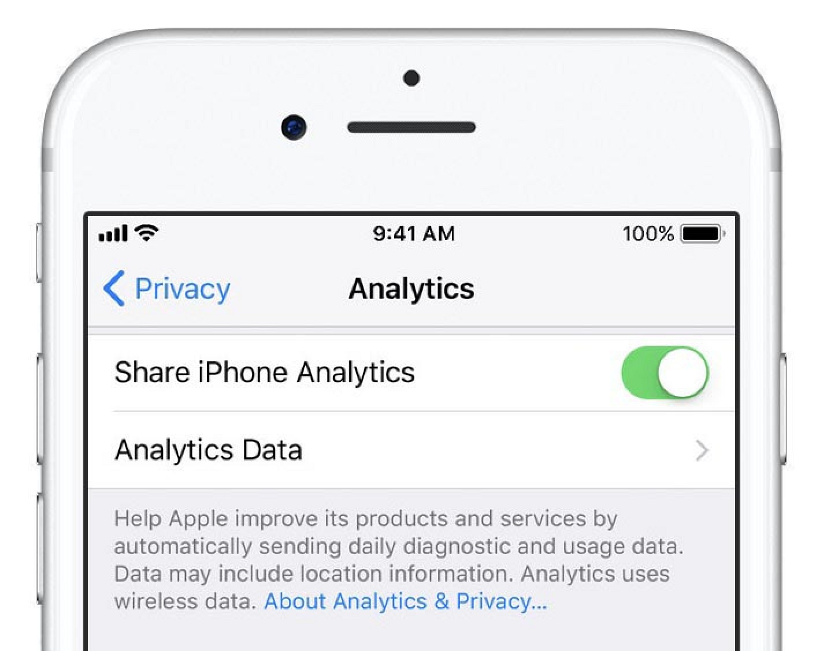
Apple Differential Privacy
Notes:
Starting with iOS 10, Apple is using Differential Privacy technology to help discover the usage patterns of a large number of users without compromising individual privacy. To obscure an individual’s identity, Differential Privacy adds mathematical noise to a small sample of the individual’s usage pattern. As more people share the same pattern, general patterns begin to emerge, which can inform and enhance the user experience. In iOS 10, this technology will help improve QuickType and emoji suggestions, Spotlight deep link suggestions and Lookup Hints in Notes.

Slide 14
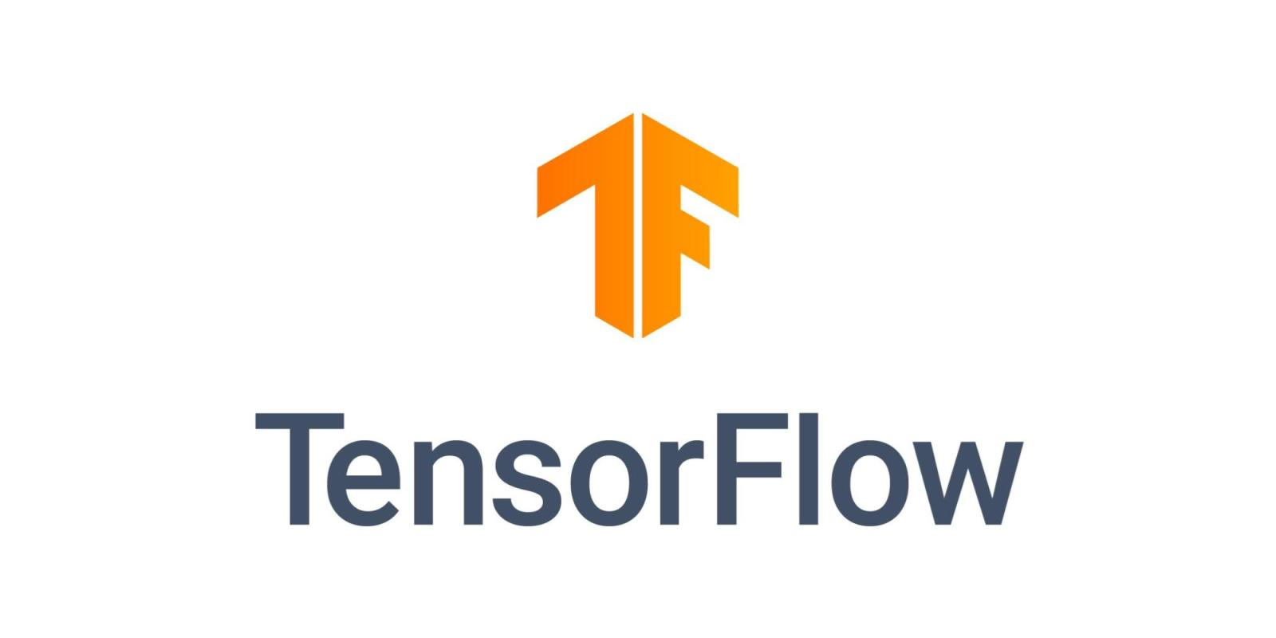

Other adoptions

Slide 15
Differential Private Applications

Slide 16
Applications: Location Privacy
Locations visited, e.g., hospitals, banks
Trajectories
…
DP solutions: add “noise” the to real locations or trajectories

Slide 17
Applications: Privacy Preserving Location Proof
Location based services:
- reward offered to users in a certain geographical location
- doctors or nurses have to prove they are in a specific room, then they can access the related information of the specific patient.
- car insurance company requests night parking location for calculating the price
Sometimes, users want to prove they are somewhere, but not to reveal the location.
E.g., I want to prove that I am in McDonald’s, but not willing to show the exact location.

Slide 18
Other applications
Database
IoT: Edge computing
Crowdsourcing
Machine learning
……

Slide 19
Differential privacy in Artificial Intelligence

Slide 20
Federated learning framework
(diagram from the Internet)

Slide 21
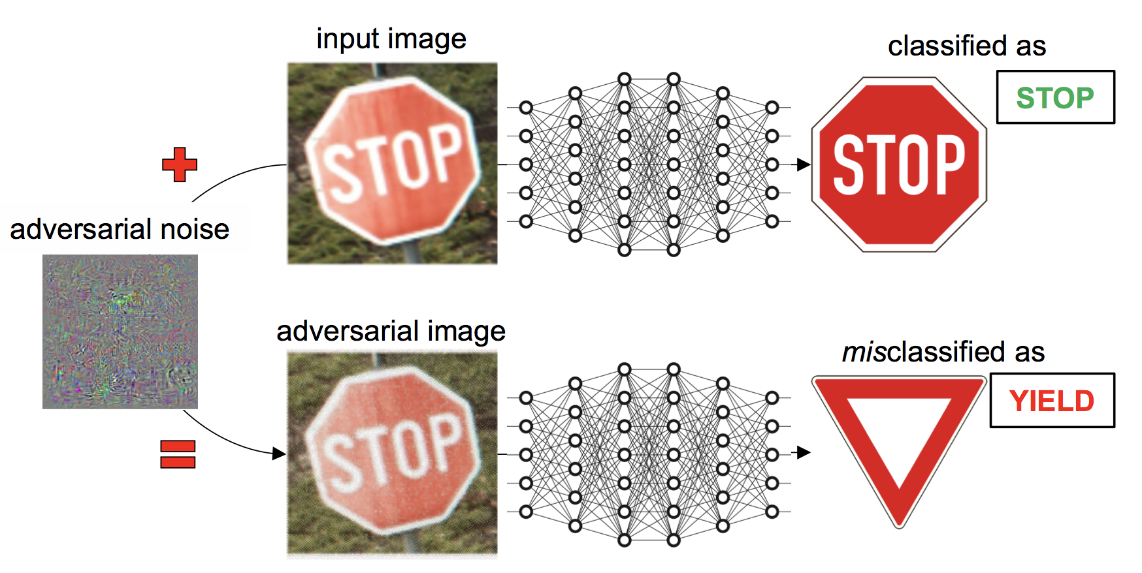
Security in AI
Deep learning adversary attack: An attacker may attack a learning model using adversarial samples.

Slide 22
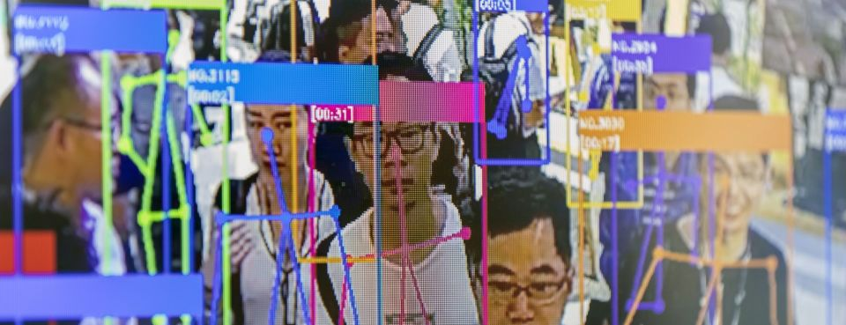
Privacy concerns in AI
Identification (face, voice, gait, …)
Linked attacks (link with social networks)
Deepfake
…
A screen demonstrates facial-recognition technology at the World Artificial Intelligence Conference in Shanghai on Aug. 29, 2019.
https://news.bloomberglaw.com/privacy-and-data-security/clearview-ai-faces-biometric-privacy-claims-in-illinois-court

Slide 23
Security and Privacy in AI
Challenges:
Attacks on models
Malicious participants
Model fairness and robustness
……
Possible solutions:
Cryptography
Differential privacy
Federated learning framework
…

Slide 24
The properties of differential privacy
Preserving privacy. This is the original purpose of differential privacy. By hiding an individual in the aggregate information, differential privacy can preserve the privacy of participants in a dataset.
Stability. Differential privacy mechanisms ensure that the probability of any outcome from a learning algorithm is unchanged by modifying any individual record in the training data.
Security. Security relates to malicious participants in a system. Differential privacy mechanisms can reduce the impact of malicious participants in AI tasks.
Fairness. In machine learning, a given algorithm is said to be fair, or to have fairness, if its results are independent of sensitive attributes, like race and gender.
Composition. Differential privacy mechanisms can guarantee that any step that satisfies differential privacy can construct a new algorithm that also satisfies differential privacy.

Slide 25
Differential privacy in fairness
Fairness in Model: systems trained to make decisions based on historical data will naturally inherit the past biases.
Differential privacy mechanisms attempt to achieve fairness by defining probabilistic mapping from individuals to an intermediate representation.
Exponential mechanism can be used to re-sample the universal data to avoid bias.
Dataset Assurance, data verification, ….

Slide 26
Attacks in the deep neural networks
Membership inference attack.
infer whether or not a given record is in the present training dataset
Attribute inference attack.
learn hidden sensitive attributes of a test input given access to the model and information about the non-sensitive attributes.
Refer to Chapter 2 of the reference book (Security and Privacy in Federated Learning)

Slide 27
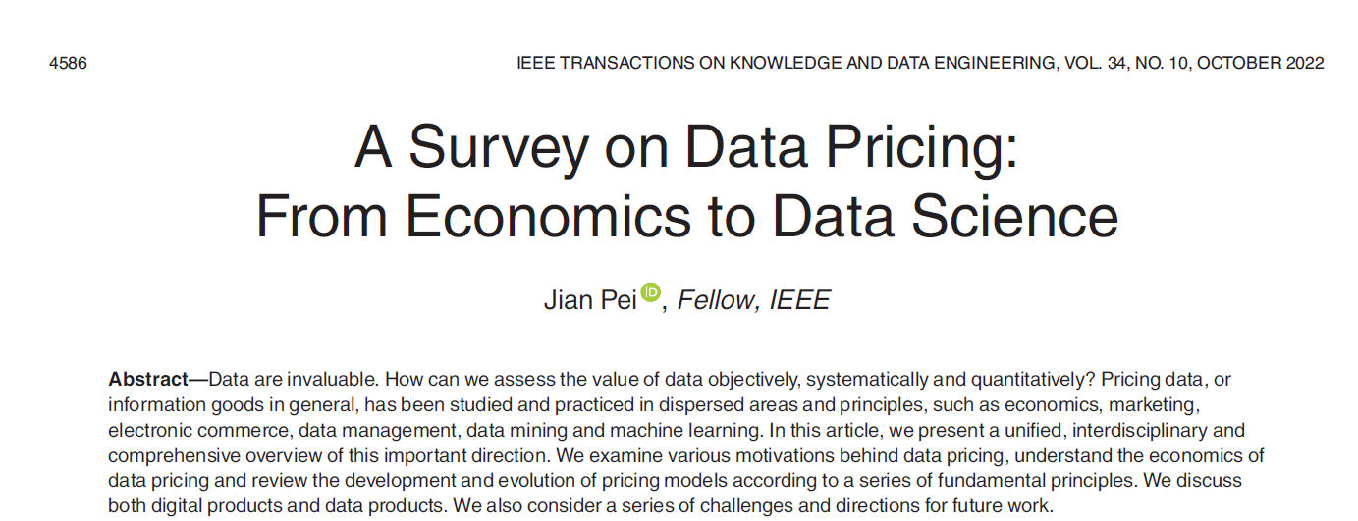
Privacy Trading
Privacy pricing (cybersecurity + economics)
Privacy pricing mechanism and tools
Pricing execution – market construction

Slide 28
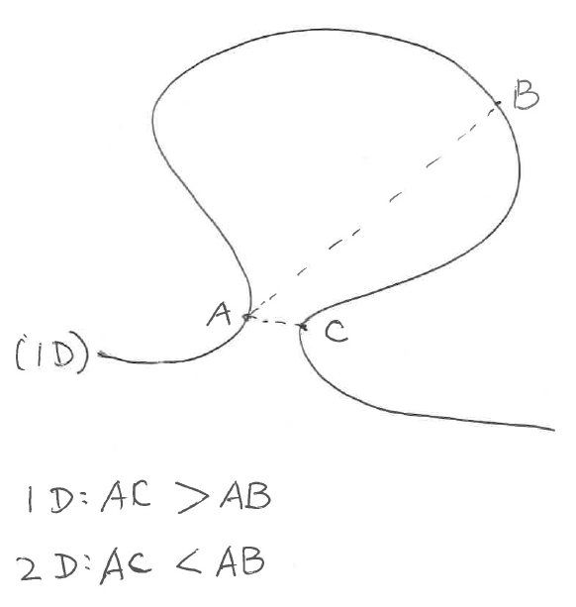
Challenges in AI Privacy and Security
Dimension curse (challenges)
Algorithms work in low dimension, may NOT work in high dimension
Current hot topics
Explainable AI (XAI)
Explainable Security (XSec)
…

Slide 29

Thank you & Questions

